Slide 1
Sketching with Hardware
08: Electronics 03 (Digital Electronics)

Slide 2
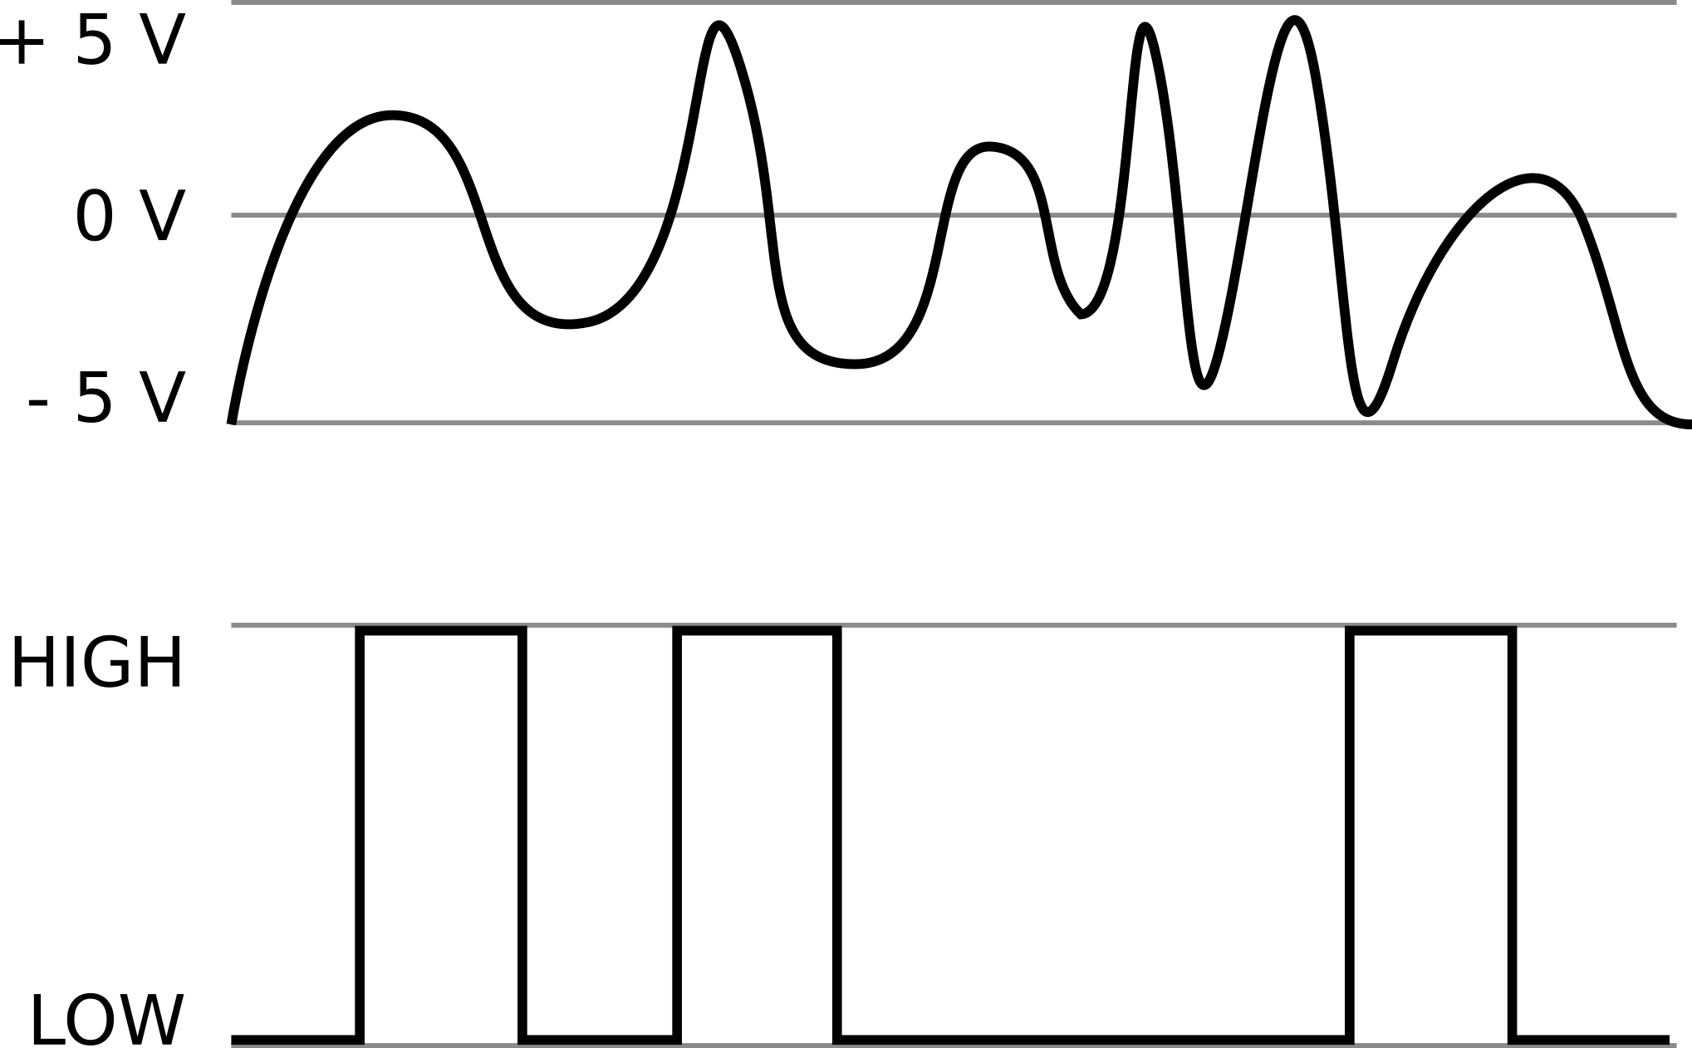
Analog vs Digital
Analog
Digital

Slide 3
Pros and Cons of Digital Signals
Clearly defined – either there is voltage or not
Less prone to errors and noise
Can be saved and reproduced easily
But:
Less information than analog “original”
Digital components are more complex

Slide 4
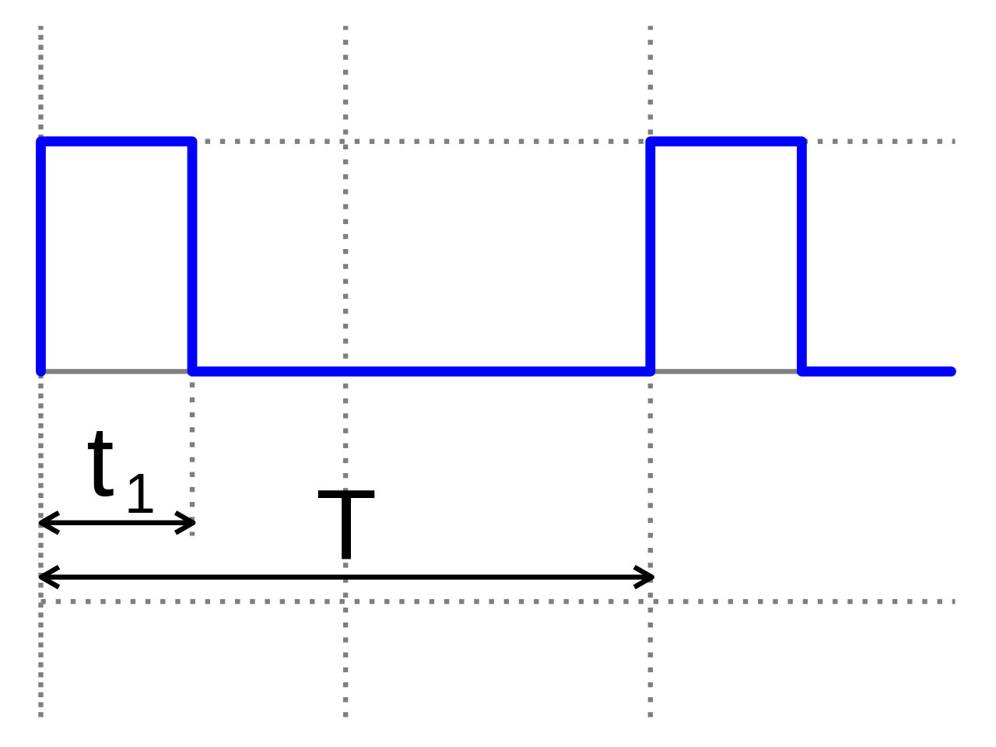
Pulse Width Modulation (PWM)
Digital “simulation” of analog signal
$U=U_{HIGH}∗\frac{t_{1}}{T}$
U_{HIGH}
Signal is HIGH for a certain part (t₁) of the time interval T and LOW for the remaining time
Net voltage over T corresponds to the HIGH voltage times the ratio of t₁ to T
Image: https://upload.wikimedia.org/wikipedia/commons/thumb/9/9b/Pulse_wide_wave.svg/1280px-Pulse_wide_wave.svg.png

Slide 5

Live Demo...
https://commons.wikimedia.org/wiki/File:USAF_EOD_explosion.jpg

Slide 6
Serial Data Transfer
The Arduino Micro has two serial ports:
Serial communicats with the computer via USB
Serial1 uses the pins RX (receive) and TX (transceive) to communicate with connected devices
Activity over serial ports is indicated by two LEDs (RX and TX)
The baudrate has to be defined beforehand and has to match between the devices
Arduino: Serial.begin(baudrate);
PC: Dropdown menu of Serial Monitor

Slide 7
Inter-Integrated Circuit (I²C)
Bidirectional, serial data bus using the Master/Slave model
Multiple slaves can be connected to one master
Requires two lines:
Serial Clock (SCL): Controls transfer rate by alternating between HIGH and LOW
Serial Data (SDA): Transfers data (one bit per clock cycle)
The first transferred byte defines receiver an direction

Slide 8
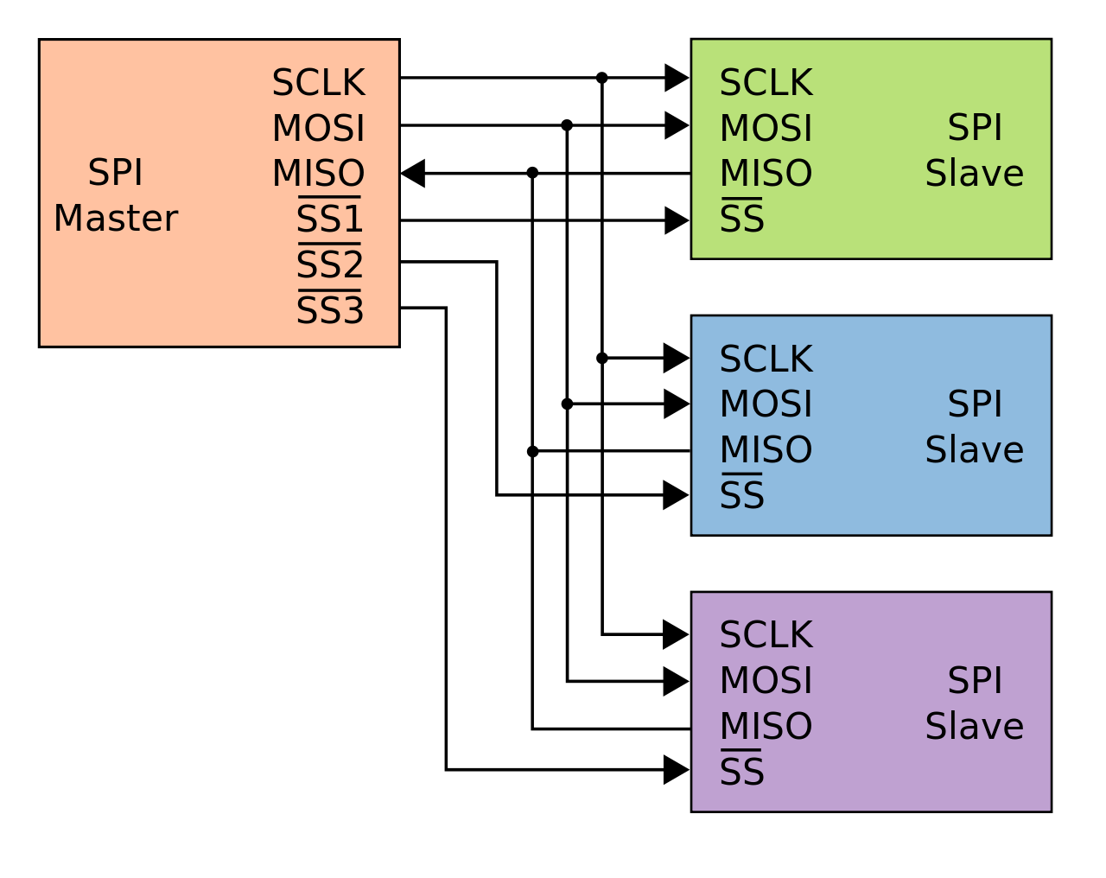
Serial Peripheral Interface (SPI)
Synchronous, serial data bus using the Master/Slave model
Three common lines:
SCLK (Serial Clock)
MISO (Master in, Slave out)
MOSI (Master out, Slave in)
One SS (Slave Select) line from the Master to each Slave
Once a Slave is selected by the Master (by setting its SS to LOW), it “listens” on MOSI and answers over MISO
Image: https://de.wikipedia.org/wiki/Datei:SPI_three_slaves.svg

Slide 9
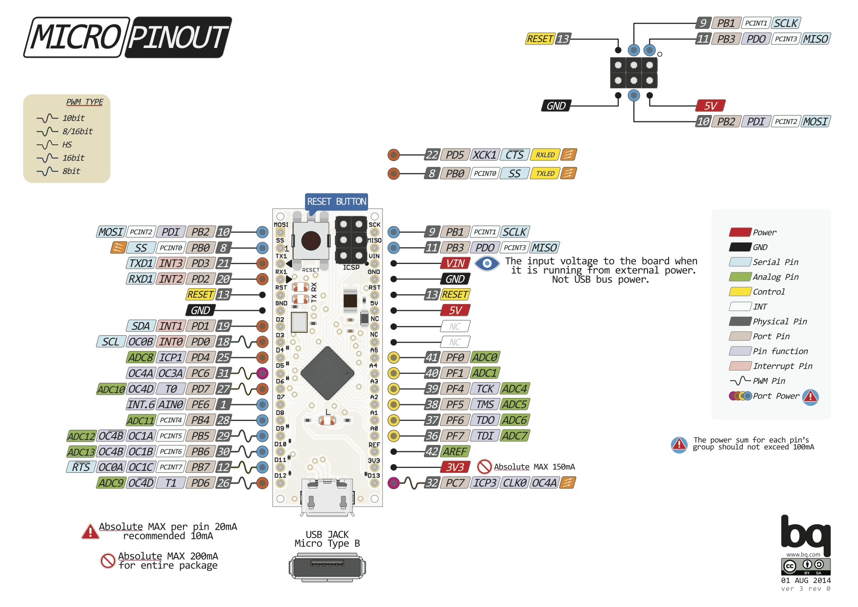
Image: Arduino Forum, User pighixxx, http://forum.arduino.cc/index.php?topic=148734.0

